Slide 1
COMPARATIVE ANALYSIS OF MACHINE LEARNIG AND DEEP LEARNING MODELS FOR REAL ESTATE PRICE PREDICTION IN DUBAI Aneesa kp may 2025

Slide 2
agenda
Introduction
Literature Review
Research Methodology
Implementation and Analysis
Result and Evaluation
Conclusion and Recommendation

Slide 3
introduction
Dubai's real estate: fast-growing, luxury-driven, and investment-heavy
Strategic global hub with high-value, volatile property transactions
Prices influenced by location, type, developer, and global factors
Why Price Prediction Matters
Informs investors, developers, brokers, and policymakers
Reduces financial risk and uncovers profitable opportunities
Helps navigate market heterogeneity and regulatory shifts
Market Challenges
Economic cycles and property diversity complicate predictions
Frequent regulatory changes
Limited structured and historical data

Slide 4
Dubai’s Real Estate Appeal
High rental yields (6%–8%) and capital appreciation
Tax-free returns attract local and global investors
Lifestyle, affordability, and post-COVID demand boost market activity
Dubai’s Rise as a Global Hub
Iconic architecture (e.g., Burj Khalifa), rapid urbanization
Bridges Asia, Europe, and Africa
Pro-investment policies and modern infrastructure
Study Goals
Perform a comparative study of ML and DL models
Improve predictive accuracy of Dubai property prices
Identify the most robust and scalable model

Slide 5
Machine Learning Models Used
Traditional Models:
Support Vector Regression (SVR)
Random Forest (RF)
Gradient Boosting Regression (GBR)
Extreme Gradient Boosting (XGBoost)
Ridge & Lasso Regression
Chosen for interpretability and solid performance
Deep Learning Models Used
Advanced DL Models:
Transformer, TabTransformer, FT-Transformer
Gated Recurrent Unit (GRU)
Deep & Cross Network (DCN)
Capture complex, non-linear, and temporal relationships

Slide 6
Evaluation Metrics
MAE: Measures average error magnitude
RMSE: Penalizes large errors more
R² Score: Indicates overall model fit
ML vs. DL Models
ML Models:
Require manual feature engineering
Good baseline performance
DL Models:
Automatically learn patterns
More scalable and accurate for large, complex datasets

Slide 7
Aim and Objectives
Aim: Compare ML and DL models for accurate Dubai real estate price prediction
Objectives:
Collect and preprocess historical real estate data
Handle missing values, outliers, and normalize using Z-score
Apply and evaluate multiple ML and DL models
Assess performance using MAE, RMSE, and R²

Slide 8
Significance of the Study
Supports investors and stakeholders with accurate price forecasts
Helps reduce price bubbles and market uncertainty
Uses ML & DL models to uncover deep patterns in real estate data
Enhances decision-making in Dubai’s dynamic market
Scope of the Study
Covers data collection, preprocessing, and model evaluation
Compares ML and DL models for prediction accuracy
Considers market trends and key property factors (location, project type, etc.)
Aims to guide smart investment decisions in Dubai real estate

Slide 9
Literature review
ML & DL in Real Estate Price Prediction
ML & DL offer high accuracy and detect complex patterns in property valuation
Essential for dynamic markets like Dubai—supporting pricing, investment, and urban planning
DL models (e.g., CNNs, LSTMs, GRUs) handle structured & unstructured data (e.g., maps, text)
Enable smart housing, energy efficiency, and sustainable city development
Challenges include data transparency, interpretability, and computational costs
Explainable AI (XAI) and lightweight models are addressing adoption barriers
Key Research Insights
Ahmad et al. (2020) show DL’s edge over traditional ML globally
Elnaeem Balila et al. (2023) compared eight ML algorithms, finding hybrid EEMD-SD-SVM and SVM models highly accurate for Dubai’s price prediction
Al Shamsi et al. (2022) highlight limited DL applications in Dubai’s property sector
Sharma & Ahuja (2023) stress the need for market-specific DL models for diverse urban environments

Slide 10
Conclusion
Despite Dubai’s tech-forward real estate sector, DL remains underutilized
This research bridges the gap by evaluating ML and DL models tailored for accurate, scalable property price prediction in Dubai’s evolving market

Slide 11
Research methodology
Compare advanced Machine Learning (ML) and Deep Learning (DL) models for accurate real estate price prediction in Dubai.
Helps investors, buyers, sellers, and brokers make data-driven decisions based on key features like location, size, and market trends.
Data Source & Type: Uses structured Dubai Land Department (DLD) data with categorical (e.g., location, type) and numerical (e.g., size, price) features.
ML Models: Implements SVR and Random Forest to efficiently handle structured data and identify important predictive features.
DL Models: Incorporates TabTransformer for capturing complex feature interactions and GRU for modelling time-based price trends.
Hybrid Approach Advantage: Combines ML and DL strengths to deliver robust, accurate, and scalable real estate price predictions.

Slide 12
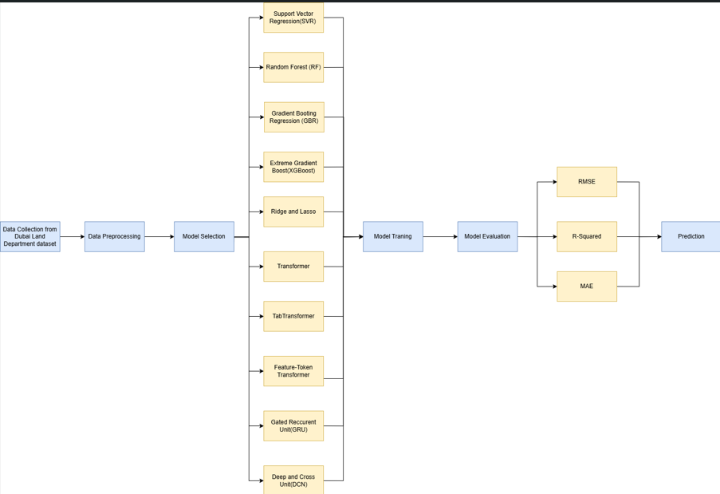
Proposed Research Framework

Slide 13
Data Preprocessing
Handling Missing Data
Categorical Feature Encoding.
Normalization/Standardization
Outlier Detection and Treatment
Feature Selection
Model Selection
Evaluate ML models: SVR, Random Forest, GBR, XGBoost, Ridge, Lasso
Evaluate DL models: Transformer, TabTransformer, FT-Transformer, GRU, DCN
Select model based on accuracy, complexity handling, and generalization ability

Slide 14
Model Training
Train each model on historical real estate data
ML models learn from features and trends
DL models use neural networks to capture deep, sequential, and non-linear patterns
Optimize parameters to minimize prediction error
Model Evaluation
RMSE: Measures average prediction error magnitude
MAE: Measures average absolute prediction error
R² Score: Indicates how well the model explains the data variance
Prediction
Use trained models to estimate property prices on unseen (test) data
Predict outcomes based on learned patterns and input features
Compare predicted values against actual prices for performance evaluation

Slide 15
Implementation and analysis
Data Preprocessing Overview
Loaded DLD Transactions Open Dataset: 1,339,796 rows, 46 columns
Selected 5% random sample (66,990 records) for efficient processing
Removed Arabic columns to simplify analysis
Feature Selection
Retained 13 key features critical to price prediction
Property type, sub-type, number of rooms, parking
Sale price per sqm, procedure area, transaction group
Registration & usage types, party roles
Actual Worth chosen as the prediction target (final property price)

Slide 16
Outcome
Reduced data complexity and noise.
Enhanced efficiency and accuracy of ML/DL modelling.
Categorical Variables | property_type_en, property_sub_type_en, reg_type_en, property_usage_en, rooms_en, trans_group_en
Numerical variables | Has_parking, meter_sale_price, no_of_parties_role_1, no_of_parties_role_2, no_of_parties_role_3, procedure_area, actual_worth

Slide 17
Data Cleaning – Handling Outliers
Key numerical features with outliers:
meter_sale_price, actual_worth, procedure_area
Impact of outliers:
Skew distributions
Reduce model accuracy and increase bias
Solution: Interquartile Range (IQR) Method
Calculate Q1 and Q3, then IQR = Q3 - Q1
Identify outliers as values < Q1 - 1.5×IQR or > Q3 + 1.5×IQR
Action Taken:
Outliers removed to enhance model performance and data reliability

Slide 18
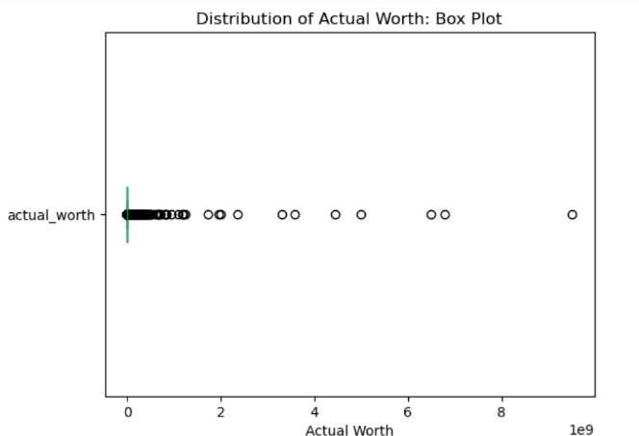
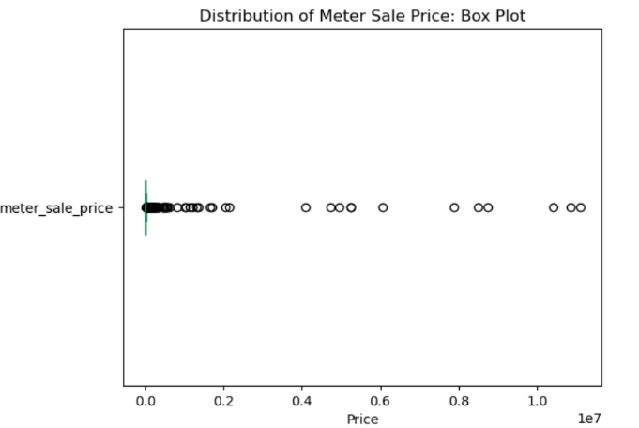
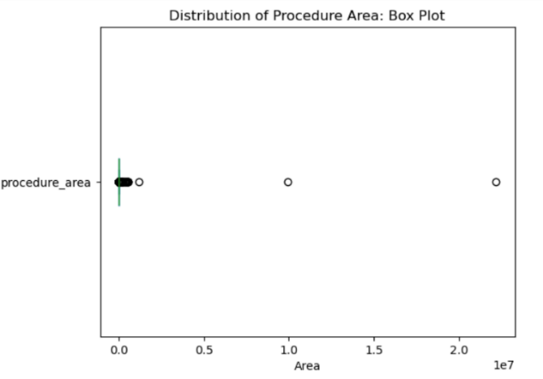
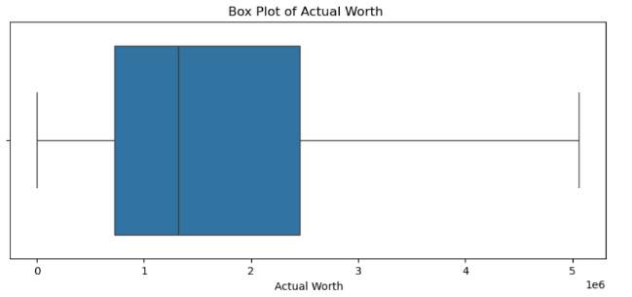
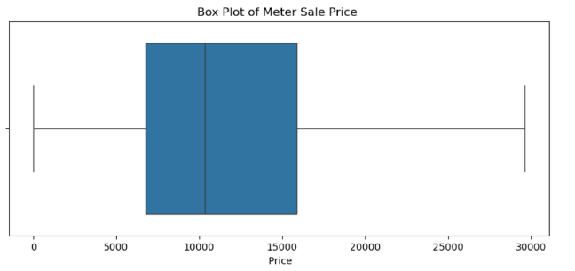

Numerical Features before handling outliers
Numerical Features After Handling outliers

Slide 19
Box Plot Adjustments
Box plots for Meter Sale Price, Procedure Area, and Actual Worth now more compressed and balanced
Whiskers extend reasonably, reflecting reduced skewness
Improved distribution ensures representative market trends
Handling Missing Values
24% of rows had missing values, mainly in rooms_en and property_sub_type_en
96% of these occurred simultaneously in both columns
Replaced with 'N/A' to avoid losing valuable data
Remaining 4% missing values dropped for consistency
Outcome
Clean, reliable dataset with preserved data integrity
Minimized loss and ready for effective ML/DL modelling

Slide 20
Model Design Overview
Machine Learning Workflow
Applied One-Hot Encoding for categorical variables
StandardScaler used to normalize numerical features
Selected top 10 features using SelectKBest + f_regression
Dataset split: 70% training / 30% testing
Deep Learning Workflow
Key categorical features: property type, registration type, usage, room count
Applied Label Encoding for neural network compatibility
Train-test split: 80% training / 20% testing (fixed random state)
Separate normalization for numerical features (e.g., meter sale price)
Key Difference
DL models require deeper preprocessing (scaling, encoding)
ML models perform well with basic encoding and raw numerical inputs

Slide 21
Machine Learning Architectures and Training Summary
Model | Tuning Method | Key Parameters | Iterations / CV | Evaluation Metric | Parallelization | Notes
SVR | RandomizedSearchCV | kernel, C, epsilon, gamma, degree | 15 iterations / 3-fold CV | R² Score | n_jobs = -1 | Fine-tuned for high accuracy with robust cross-validation
Random Forest | RandomizedSearchCV | n_estimators, max_depth, min_samples_split, min_samples_leaf, bootstrap | 10 iterations / 3-fold CV | R² Score | n_jobs = -1 | High accuracy and efficiency with optimal parameter set
GBR | RandomizedSearchCV | n_estimators, learning_rate, max_depth, min_samples_split, min_samples_leaf, subsample | 10 iterations / 3-fold CV | R² Score | n_jobs = -1 | Trained on best config; strong gradient boosting performance
XGBoost | RandomizedSearchCV | n_estimators, learning_rate, max_depth, subsample, colsample_bytree, min_child_weight, gamma, reg_alpha, reg_lambda | 10 iterations / 3-fold CV | R² Score | n_jobs = -1 | Fully parallelized; optimized for top accuracy
Ridge | RandomizedSearchCV | alpha (np.logspace(-4, 4, 50)) | 10 iterations / 3-fold CV | R² Score | n_jobs = -1 | Regularization helps generalize the model
Lasso | RandomizedSearchCV | alpha (np.logspace(-4, 4, 50)) | 10 iterations / 3-fold CV | R² Score | n_jobs = -1 | Performs feature selection by shrinking coefficients

Slide 22
Deep Learning Model Architectures and Training Summary
Model | Input Handling | Architecture Highlights | Training | Epochs | Optimizer / Loss
Transformer | Categorical embedded; numerical direct | Transformer Encoder Block with attention, dropout, normalization | Dense layers for final prediction | 80 | Adam / MSE
TabTransformer | Categorical embedded; numerical reshaped | Multi-head attention + feed-forward layers | Flattened features passed through dense layers | 80 | Adam / MSE
FT-Transformer | All features embedded and tokenized | Attention, dropout, normalization, positional encoding | Dense layers for final prediction | 100 | Adam / MSE
GRU | Categorical embedded; numerical direct | GRU layers + batch normalization | Sequential modeling with dense layers | 100 | Adam / MSE
DCN | Categorical embedded; numerical direct | Deep dense layers + custom CrossLayer | MAE used as additional evaluation metric | 100 | Adam / MSE + MAE Evaluation

Slide 23
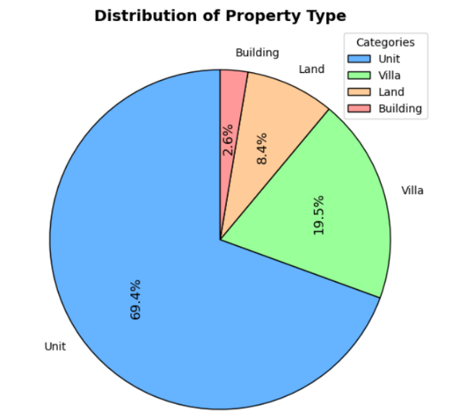
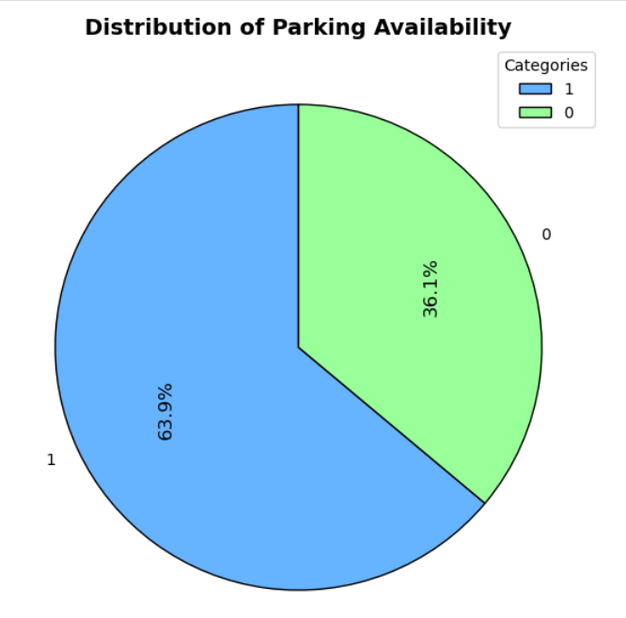
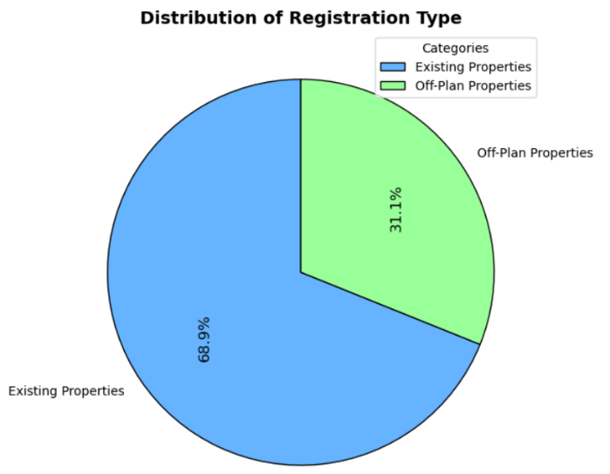
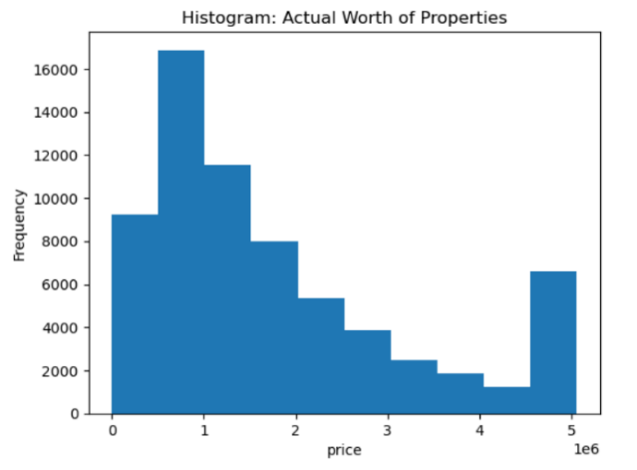
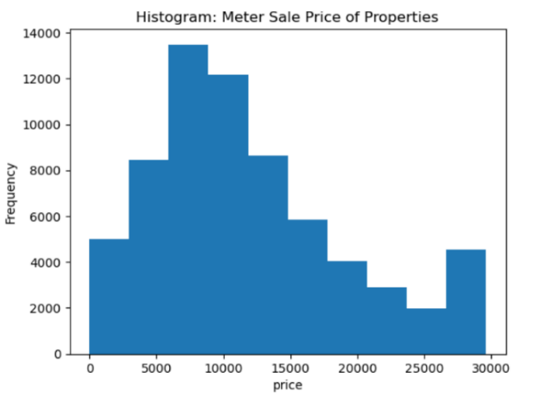
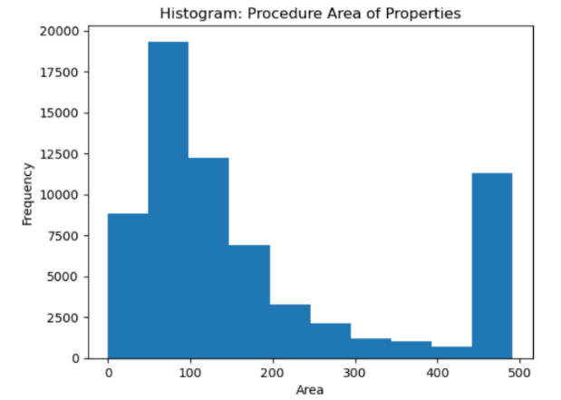
Result and analysis
Uni-variate analysis

Slide 24
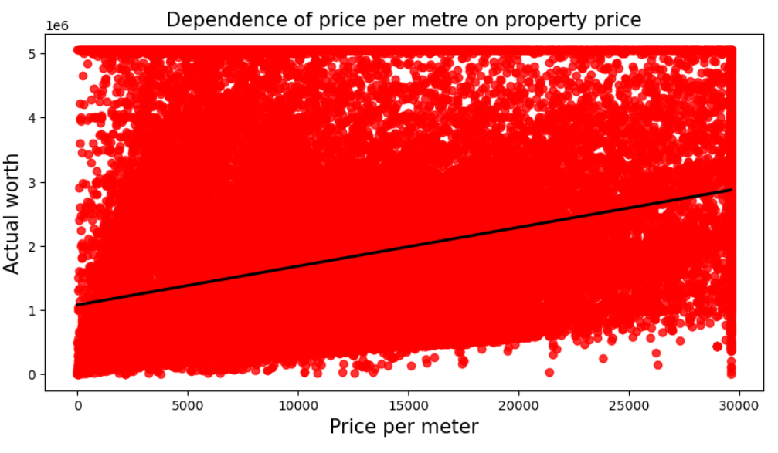
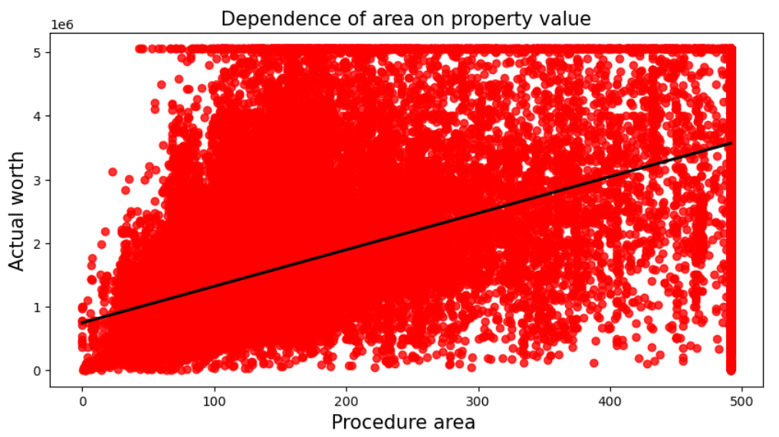
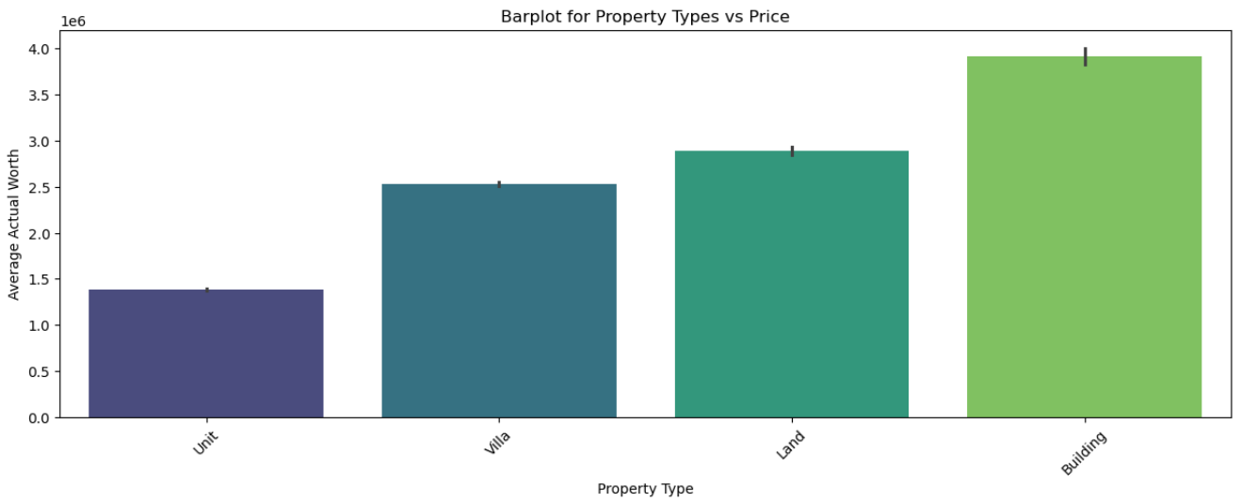
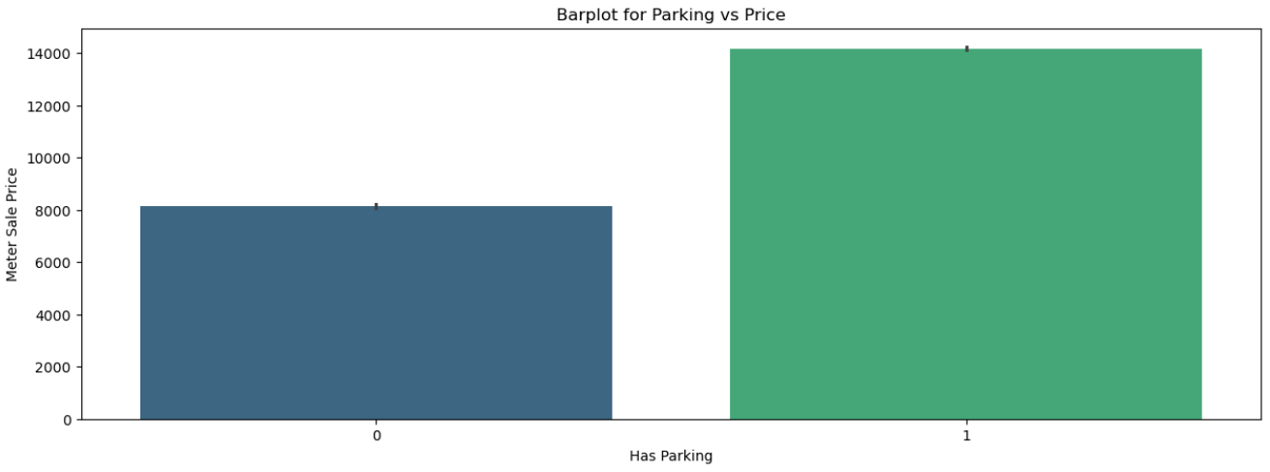
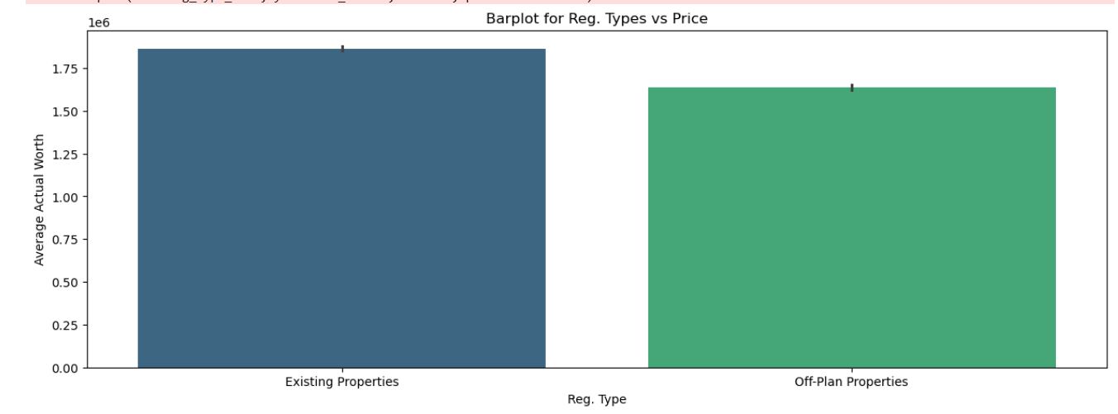
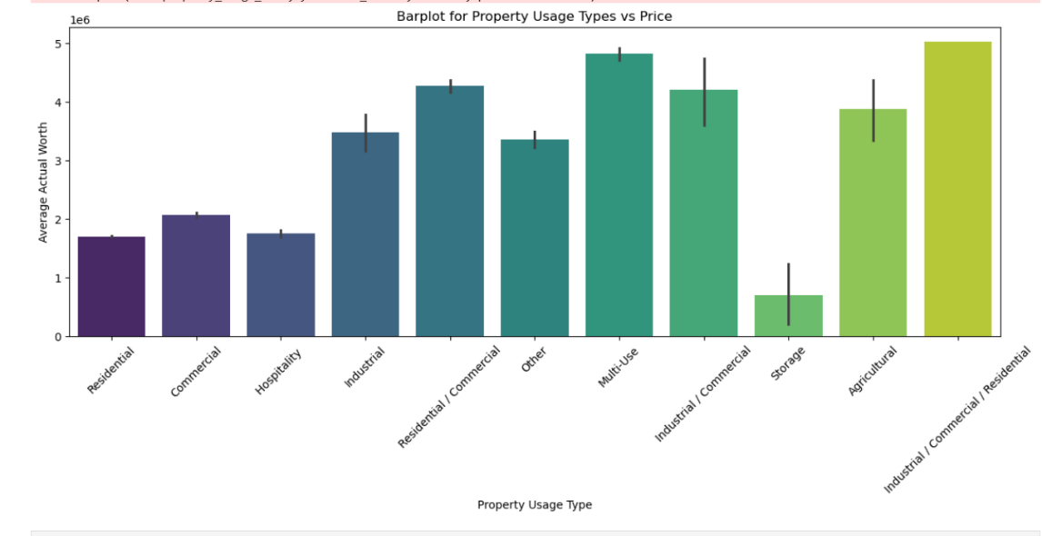
Bi-variate Analysis

Slide 25
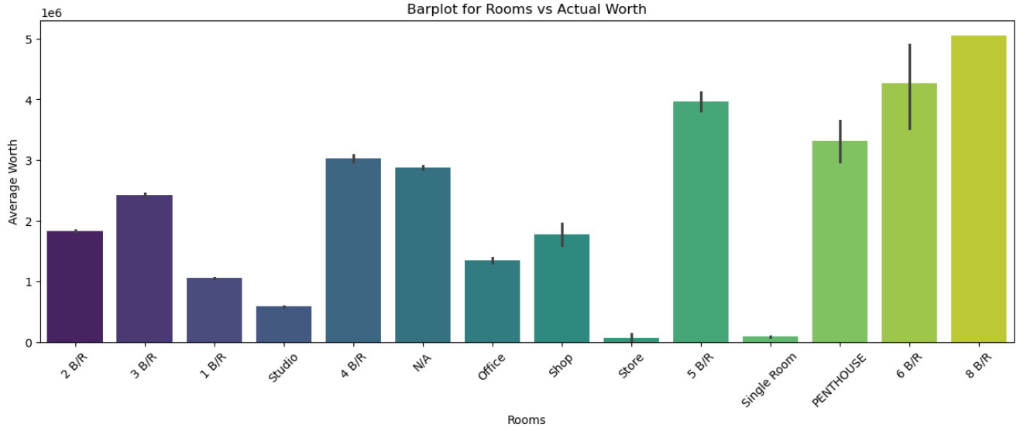
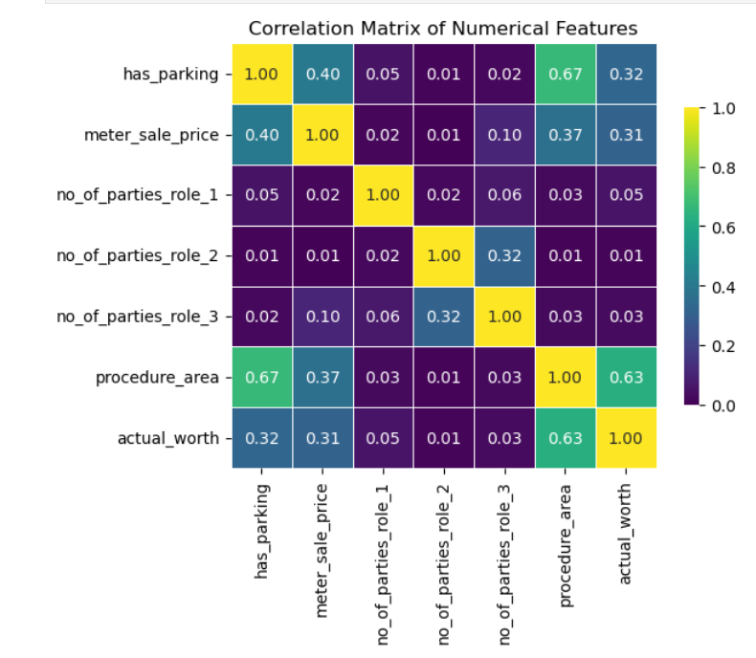
Larger properties have higher worth, while studios and commercial units show distinct pricing trends.
Heatmap
Strong correlations found. procedure_area & has_parking (0.67), procedure_area & actual_worth (0.63).
Meter_sale_price has moderate links with procedure_area (0.37) and actual_worth (0.31).
Helps in feature selection and spotting multicollinearity for better model accuracy.

Slide 26
Models Performance
Models | R² | MAE | RMSE
Transformer | 0.941135 | 153204.390948 | 345240.380448
TabTransformer | 0.941231 | 159078.810794 | 344958.337687
FT-Transformer | 0.932195 | 192833.382783 | 370530.961886
GRU | 0.927371 | 202045.598969 | 383484.412199
DCN | 0.902581 | 247148.865981 | 444135.805982
SVR | 0.608007 | 567974.863084 | 867442.661053
RF | 0.899815 | 153405.969861 | 438533.852730
GBR | 0.903424 | 164829.770647 | 430563.383624
XGBoost | 0.900025 | 153571.368843 | 438073.089860
Ridge Regression | 0.753162 | 466908.205486 | 688346.886731
Lasso Regression | 0.753150 | 467099.192273 | 688364.592799

Slide 27
Model Performance Comparison
TabTransformer is the top performer:
R²: 94.12%, RMSE: 344,958, MAE: 159,079
Excels at handling complex tabular data.
Transformer model is nearly identical:
R²: 94.11%, very minor differences in RMSE and MAE.
FT-Transformer performs well:
R²: 93.22%, but with higher error metrics vs. TabTransformer
RMSE ↑ by 7.4%, MAE ↑ by 21.3%
Traditional ML Models Overview
SVR performs worst:
R²: 60.80%, RMSE: 867K+, MAE: 568K+
Random Forest:
R²: 89.98%, MAE: 153K+, 4.14% below TabTransformer
GBR & XGBoost:
R²: ~90%, 3.78–4.12% behind TabTransformer
Ridge & Lasso:
R²: 75.32%, high error values

Slide 28
Challenges & Limitations
Data complexity: Models struggle with outliers, heterogeneity, and variance in real estate data.
Resource demands: Deep learning models need large datasets and high computational power.
Limited interpretability: Both ML and DL models offer limited transparency, hindering decision-making.
External variables: Economic shifts and policy changes are hard to model, causing prediction uncertainty.

Slide 29
Conclusion and recommendation
Key Findings and Conclusions
Property value is strongly influenced by area size and property type (e.g., buildings, land).
TabTransformer achieved the best performance with an R² of 94.12%, outperforming all other models.
Transformer-based deep learning models (TabTransformer, Transformer, FT-Transformer) captured complex, non-linear patterns more effectively than traditional ML models.
While ensemble ML models (RF, GBR, XGBoost) performed better than linear regressions, they still lagged behind DL models in accuracy and generalization.
Attention-based models excelled at learning from structured data, proving highly effective for Dubai’s dynamic real estate market.
Deep learning models demonstrate greater scalability, robustness, and suitability for high-variance property data.
Recommendations
Enhance performance using advanced tuning methods like Bayesian Optimization (Optuna), Hyperband, and PBT to reduce training costs and improve efficiency.
Future improvements include hybrid models (e.g., Transformer-GRU), self-supervised learning (SSL), and integrating external data (macroeconomics, location-based, sentiment) for robust forecasting.

Slide 30
Thank you
Aneesa KP
aneesaay11@gmail.com

